Slide 1
Tree Edit Distance with Gaps
Hélène Touzet
Information Processing Letters 85 (2003) 123–129
Presenter： Shiuan-Wen Chen
Date： May 25, 2006

Slide 2
1. Introduction
For trees, standard edit distance algorithms—[7] or more recently [4] with a O(n³ log(n)) solution—are concerned with linear gap weights induced by pointwise edit operations.
comparing RNA structures amounts to computing edit distances between trees.
It is a well-admitted fact that the insertion, or deletion, of a set of contiguous nucleotides can be assumed to result from a single mutational event.

Slide 3
2. Preliminary definitions
tree edit distance
  we are given a cost function defined on each edit operation.(ex: D=2, I=2, S=1)
  edit script 1: DDDDIIII=4*2+4*2=16
  edit script 2: SDI =1+2+2=5
  edit distance =d(A,B) = minimum cost
Tree A
Tree B
A
A
B
C
B
D
D
F

Slide 4
2. Preliminary definitions
In a sequence, a gap is defined as any contiguous piece of letters that is inserted or deleted.
Scoring gaps:
  Constant
  Affine W(l) = W_{g}+ l * W_{s}
  Convex W(l) = W_{g}+ log(l) * W_{s}
    W(l) is convex if for all l, W(l+1)-W(l) ≦ W(l)-W(l-1)
  Arbitary W(l) is any function
W(l)
l

Slide 5
2. Preliminary definitions
Definition 2 (Gapped edit distance). We introduce three elementary edit operations:
  substitution: replace a label by another label
  deletion: remove a subtree t from a tree
  insertion: insert a subtree t into a tree
In particular, inserting a subtree t has the same cost as deleting it.
We write Gap(t) for this cost.

Slide 6
3. Complexity of tree edit distance with gaps
It is clear that there exists no general polynomial algorithm for distance with arbitrary gap weights, since the number of distinct subtrees in a tree may be exponential.
We establish in this section that one cannot expect to improve easily this complexity even if we assume that the gap function is a convex function.

Slide 7
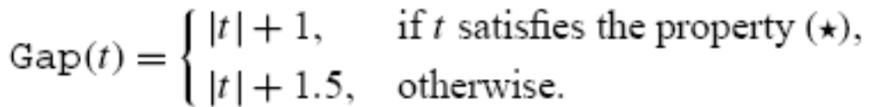
3.1. The DIST problem
Labels and trees. We compare trees built up on the infinite set of labels L = {•}∪N.
Edit costs. For the substitution costs, let
  Sub(i, •) = Sub(•, i) = 1, ∀i ∈ N,
  Sub(i, j ) = 1.5, ∀i ∈ N, ∀j ∈ N.
For the cost of insertions and deletions in gaps,
Gap is a convex function.
1
3
2
6

Slide 8
3.1. The DIST problem
INSTANCE: Two trees A and B, a natural number k.
QUESTION: d(A,B) ≦k, where the underlying cost functions used in d are Sub and Gap?
The proof of NP-hardness of DIST is performed by reducing the exact cover by 3-sets problem (X3C) to DIST.

Slide 9
3.2. DIST is NP-hard
INSTANCE: Set X = {x₁, . . . ,x_{3q}} and a collection C = {C₁, . . . ,C_{k}} of 3-element subsets of X (q ≦k).
QUESTION: Does C contains an exact cover for X.
Ex:
X={u₁,u₂,u₃,u_{4,}u₅,u₆} C={C₁,C₂,C₃}
C₁=(u₁,u₂,u₃), C₂=(u_{4,}u₅,u₆), C₃=(u₁,u₃,u₅)
Fact 1. d(A,B) ≦ 3k + q + 2 if, and only if, the associated X3C problem has a solution.

Slide 10

3.2. DIST is NP-hard
A
B
u₁
u₂
u₃
u₄
u₅
u₆
u₁
u₃
u₅
k=3
K - q = 3 – 2 = 1
C₁ C₂ C₃
If the X3C problem has a solution,there exists a subset
J = {j₁, . . . ,j_{q}}
Delete the subtree •(t_{j1}, . . . , t_{jq} ).
the cost is |•(t_{j1}, . . . , t_{jq} )|+1= 4q + 2.
(2)Substitute each remaining leaf into 0. The cost is 3(k −q).

Slide 11
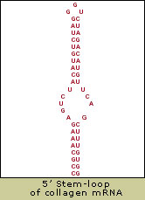
4. An easy algorithm for restricted gaps
Gaps as complete subtrees
In this case, the deletion, or insertion,
of a complete subtree corresponds to the deletion of a substructure in the RNA molecule.
stem
unpaired bases

Slide 12
4. An easy algorithm for restricted gaps
In the special case of linear gap weight function, distances with complete subtrees are equivalent to edit scripts including no deletion, neither insertion of internal nodes.
We present here an alternative approach which deals with arbitrary gap weights.

Slide 13
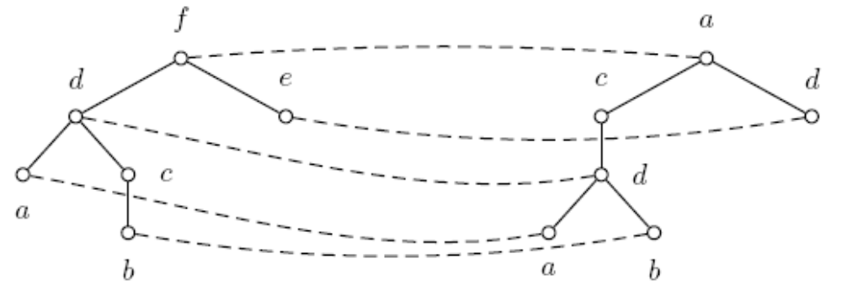
4.2. Algorithm
Definition 4 (Mapping). Let A and B be two trees,
and let e be an edit script transforming A into B.
A mapping →is a function of A→B such that
Definition 5. A mapping is a correct mapping if the associated edit script is restricted to gaps on complete subtrees.
A B
substitute
match

Slide 14
4.2. Algorithm
Lemma 3. Let f = a₁, . . . ,a_{n} and f ‘ = b₁, . . . ,b_{m} be two forests. Consider the string edit distance between f and f associated to the following costs:
a₁ a₂ a₃
f
A
B
D
the substitution cost of ai into bj is d(ai, bj )
the deletion cost of ai is d(ai, ε)
the insertion cost of bj is d(ε,bj )
C
E
b₁ b₂
f ’
B
H
C
Operation: D S D I
Then f →f is an optimal correct mapping.

Slide 15
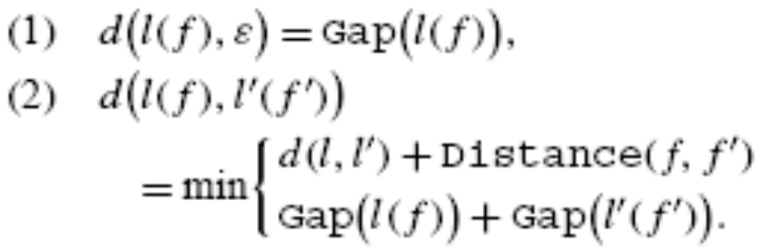
4.2. Algorithm
Fact 2 (Distance for complete subtrees).
Let l, l ∈ L, and let f , f be two forests.
Distance is the usual string edit distance, where strings are forests, that is sequences of trees.

Slide 16
4.3. Implementation and complexity
The first possibility is to build up a two dimensional table of size (|A|+1)×(|B|+1) to store the values d(i, j).
Tree A
Tree B
a₀
b₀
delete B F D A
Insert
D
B
C
A
A
A
a₁
a₂
b₁
b₂
B
C
B
D
a₃
D
b₃
F

Slide 17

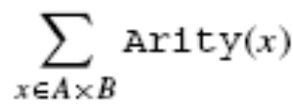
4.3. Implementation and complexity
we define the product tree structure,which is a tree labeled by the values d(i, j).
a₀*b₀
d(A,A)+Distance(a₁a₂,b₁b₂)
Gap(a₀)+Gap(b₀)
a₁*b₁ a₁*b₂ a₂*b₁ a₂*b₂
d(a₂,b₁)
Gap(a₂)+Gap(b₁)
Gap(a₃) a₃*b₃ Gap(b₃)
d(a₃,b₃)
Gap(a₃)+Gap(b₃)
Hence for the whole computation
of the product tree, the time is in

